Slide 1
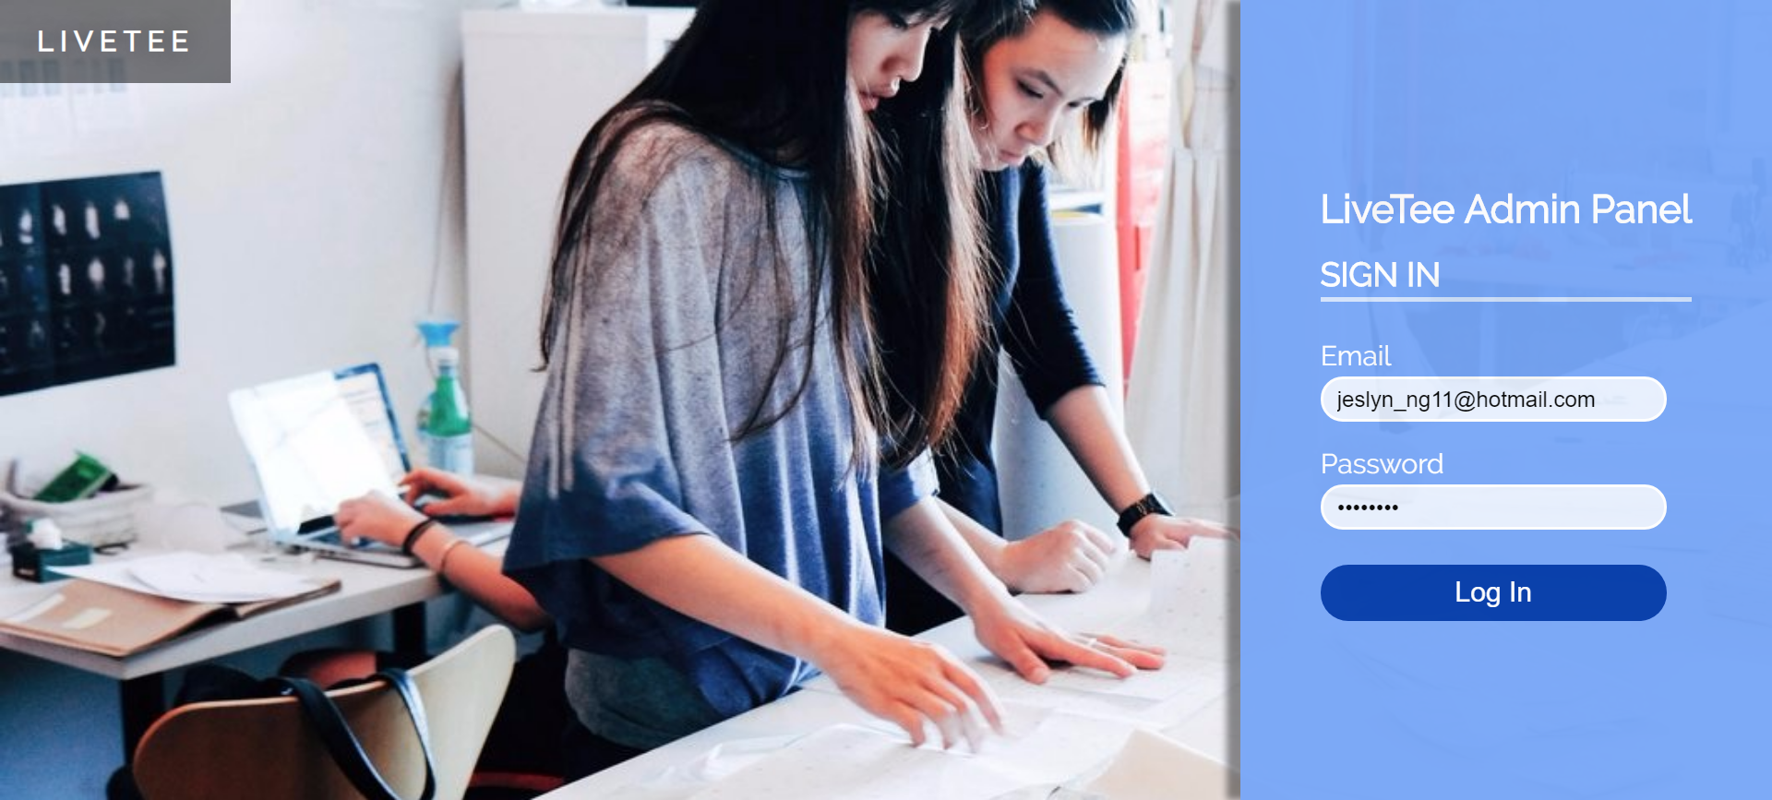
1
Login
Enter Email and Password
Click to Login

Slide 2
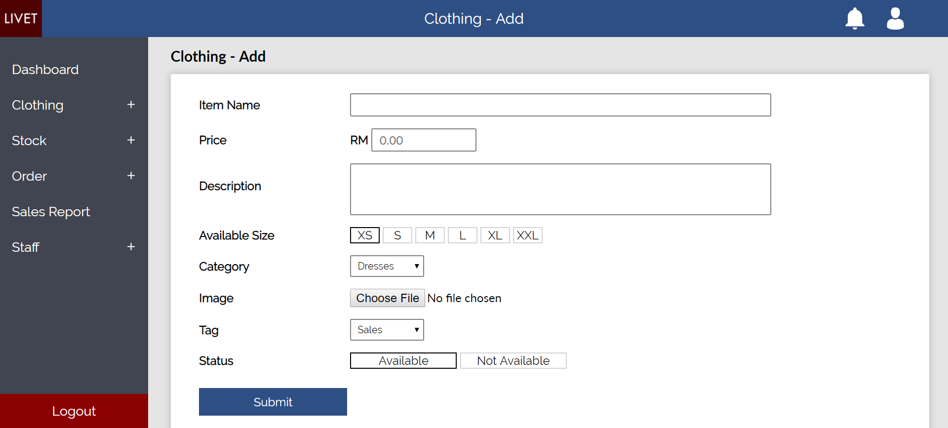
2
Clothing -> Add
Enter Clothing Details

Slide 3
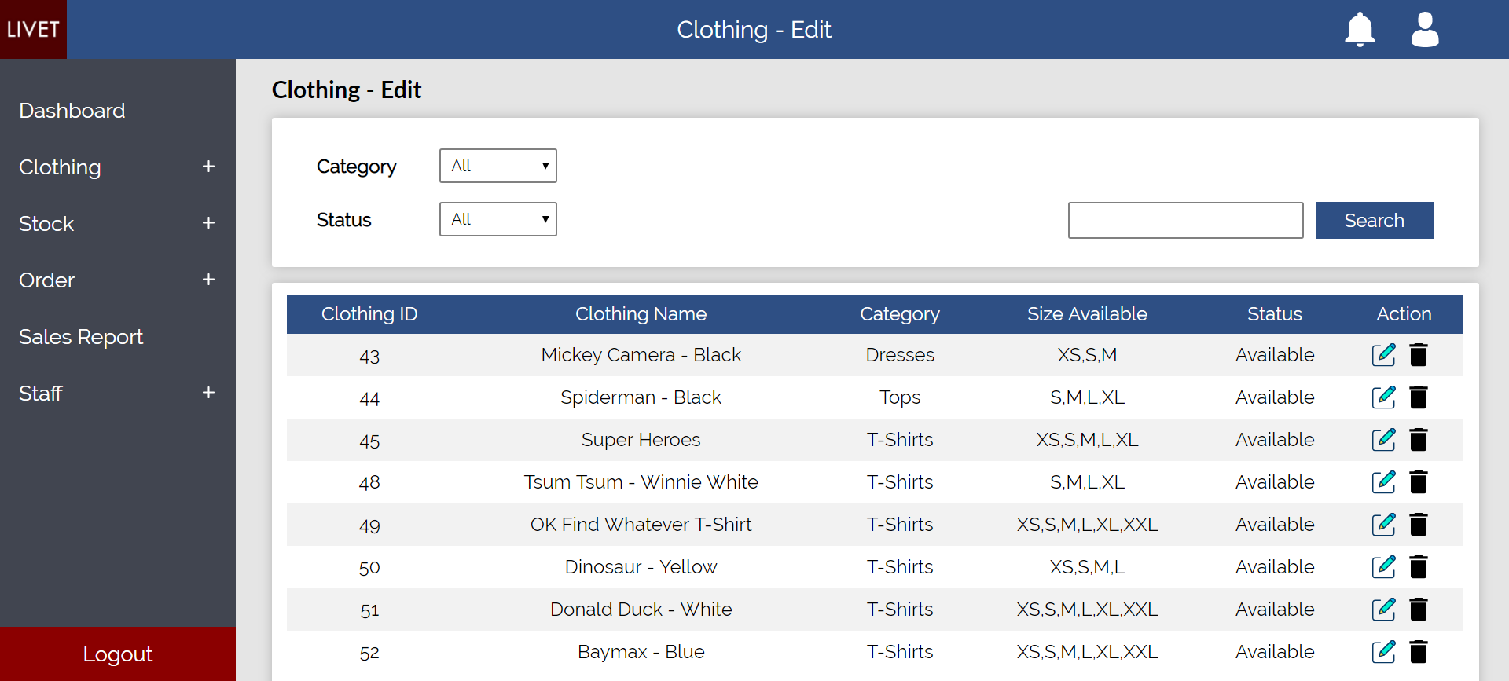
3
Clothing -> Edit
Search filter
Edit this item
Delete this item

Slide 4
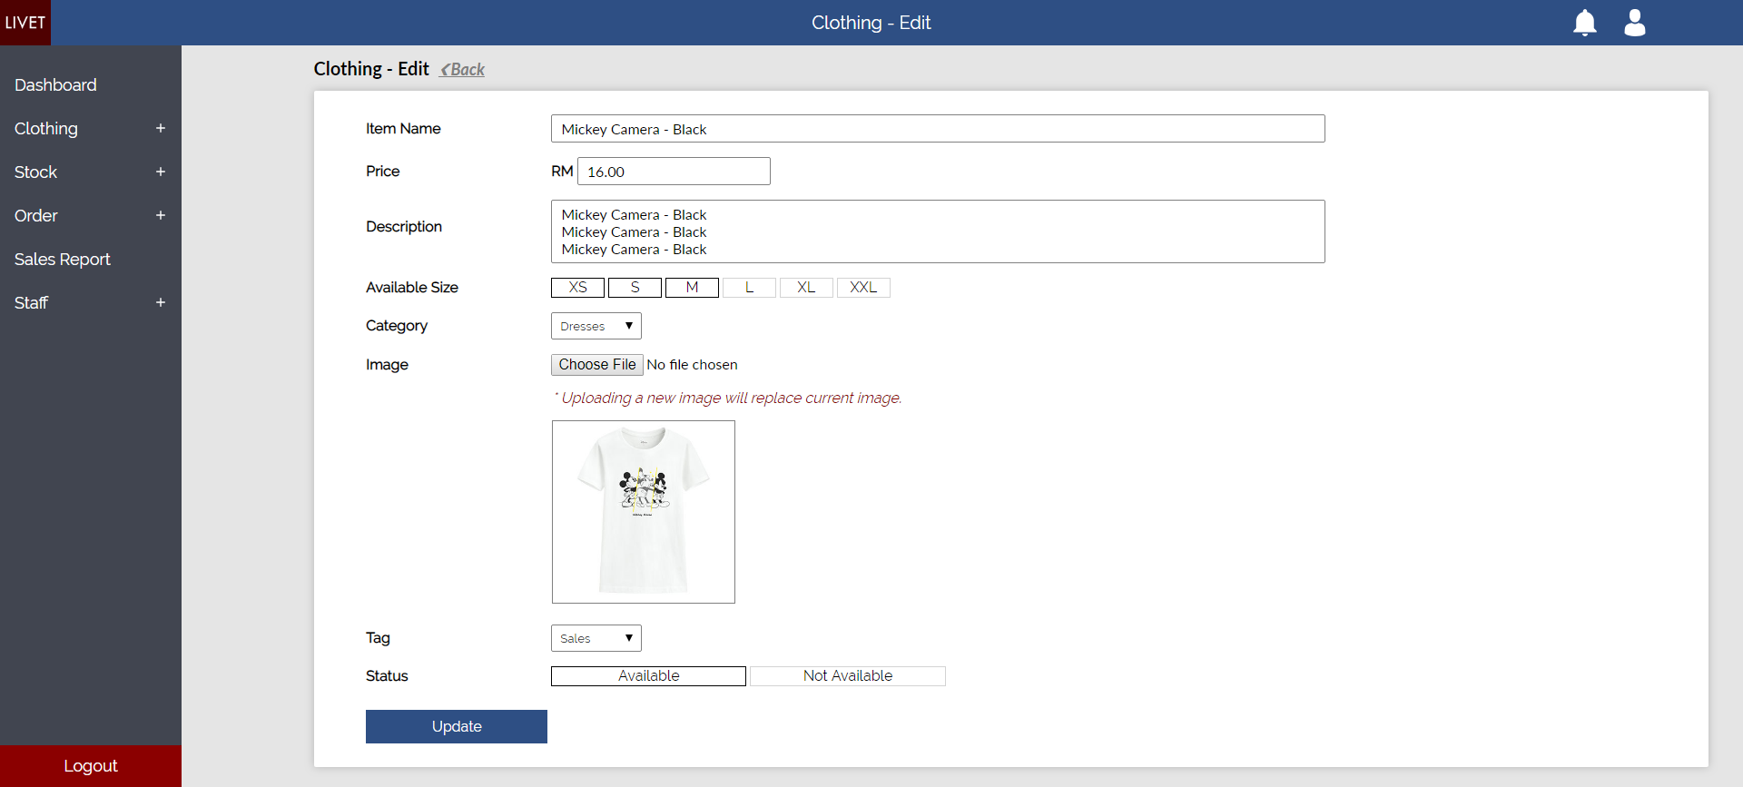
4
Clothing -> Edit -> Edit Item
Change item details

Slide 5
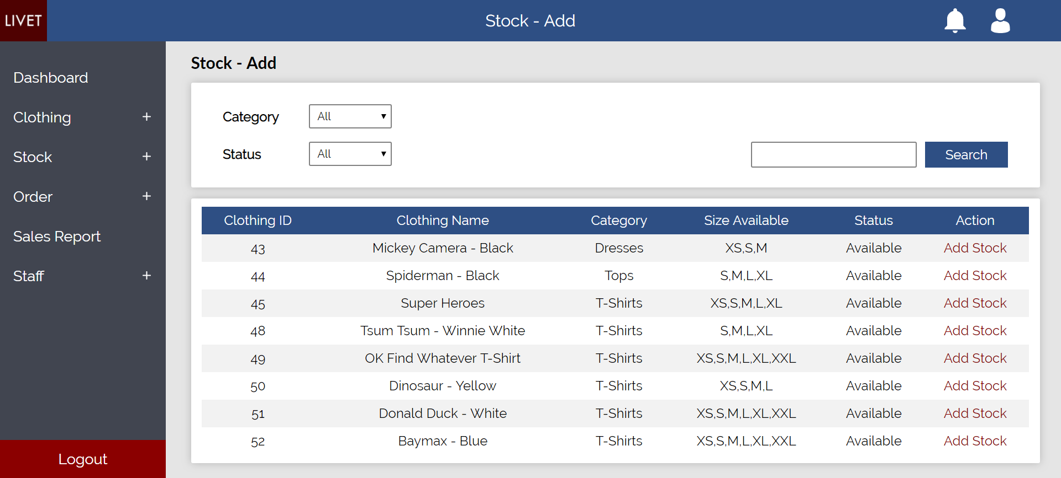
5
Stock -> Add
Search filter
Add stock for this item

Slide 6
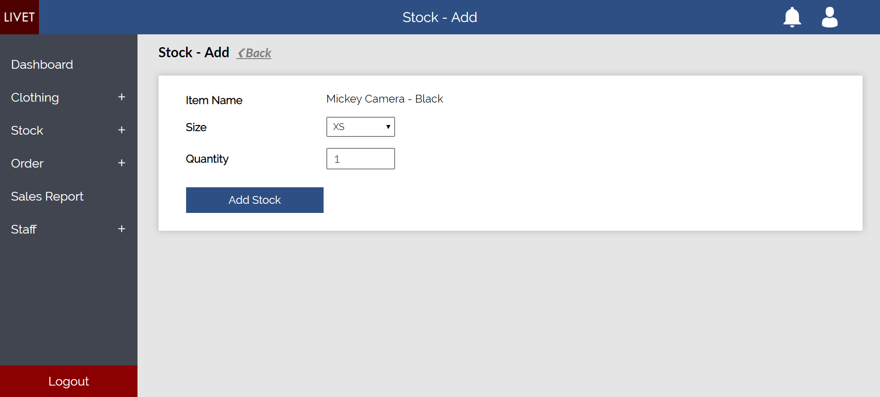
6
Stock -> Add -> Add Stock
Size of item to be restock
Restock quantity

Slide 7
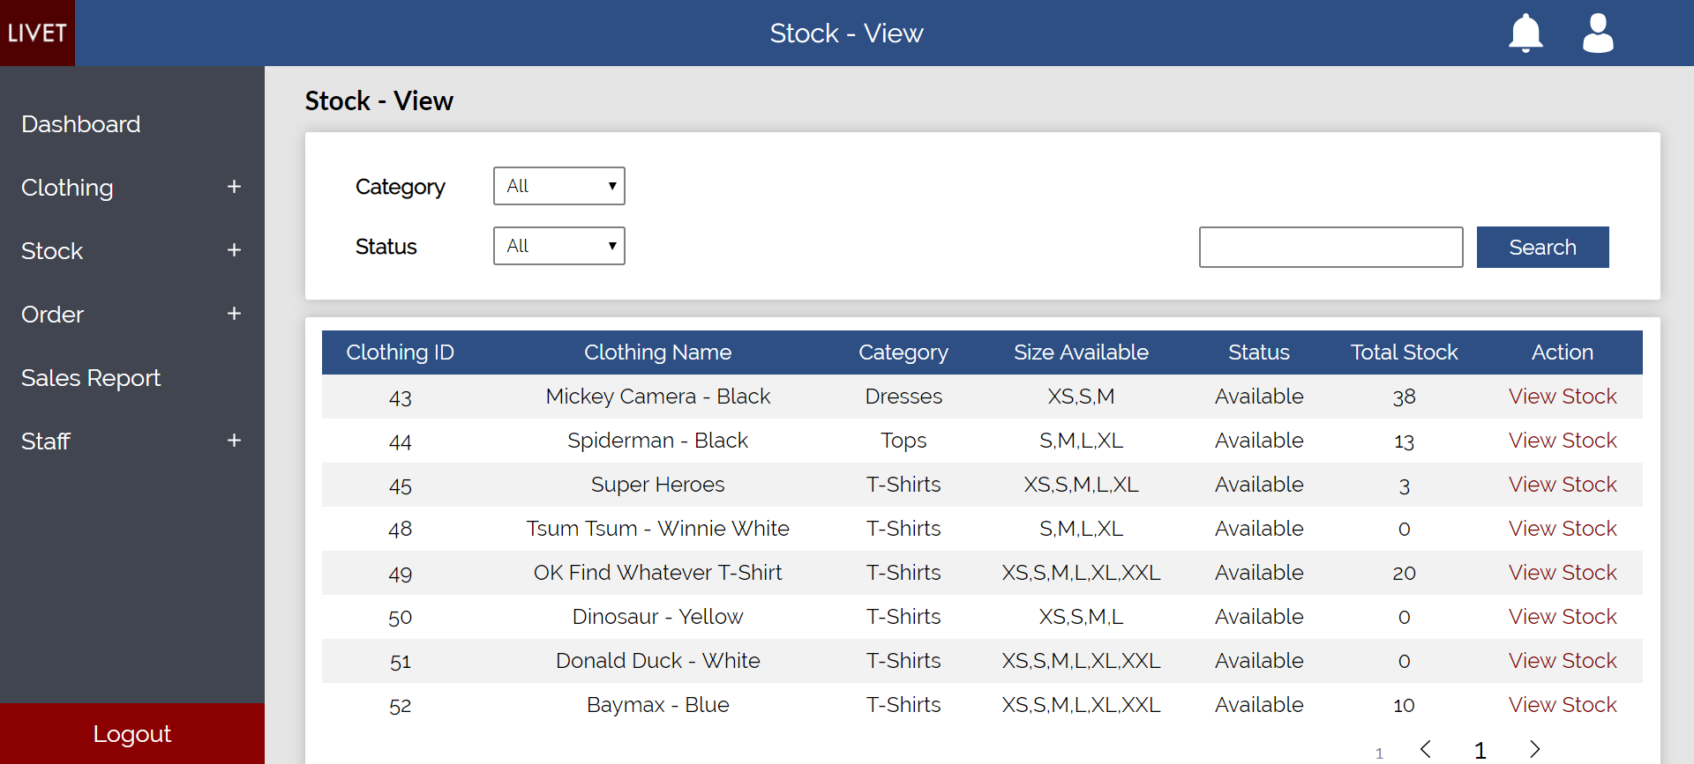
7
Stock -> View
Search filter
View stock for this item

Slide 8
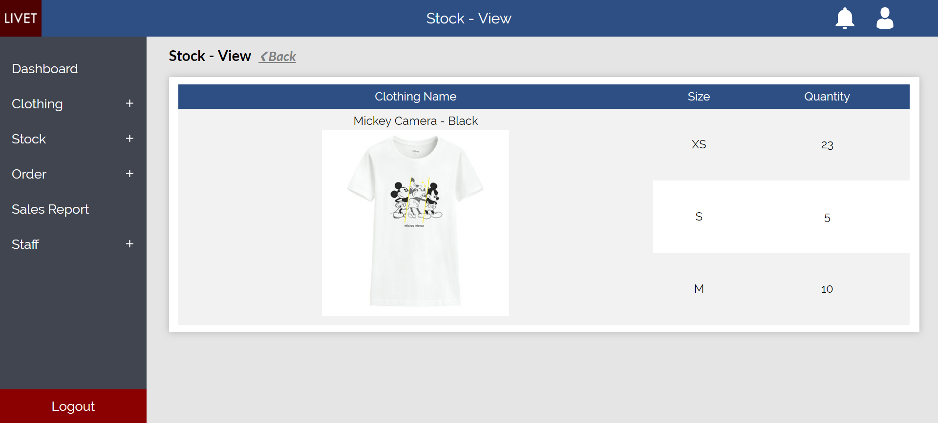
8
Stock -> View -> View Item Stock
Stock quantity for each size

Slide 9
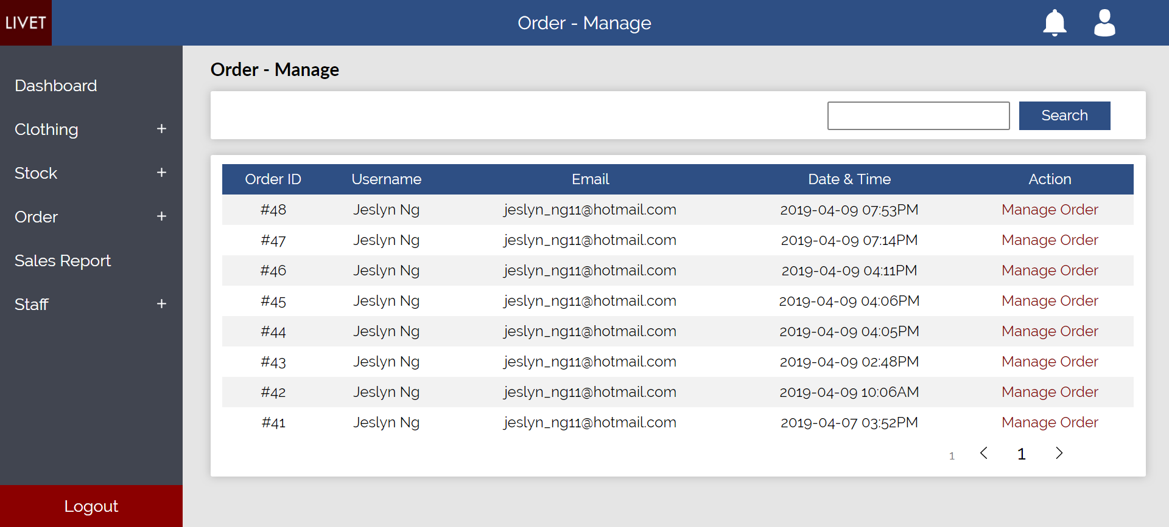
9
Order -> Manage
Search filter
Manage order for this item

Slide 10
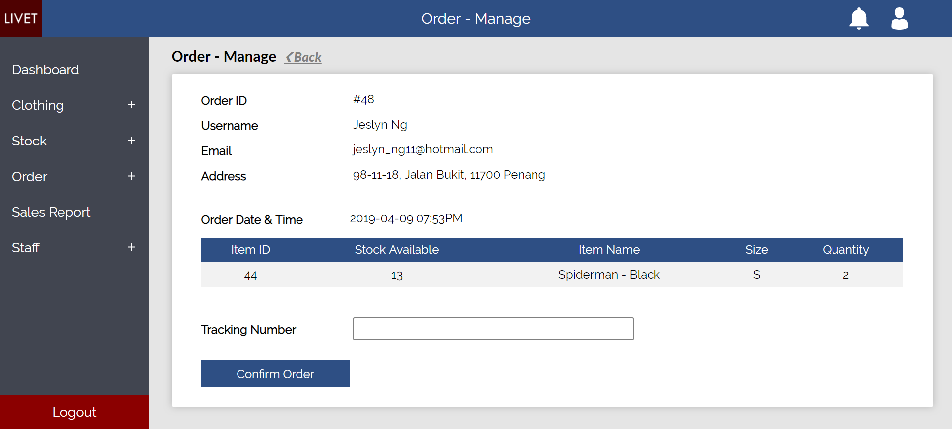
10
Order -> Manage -> Manage Order
Customer Details
Order Details
Enter tracking number for delivery

Slide 11
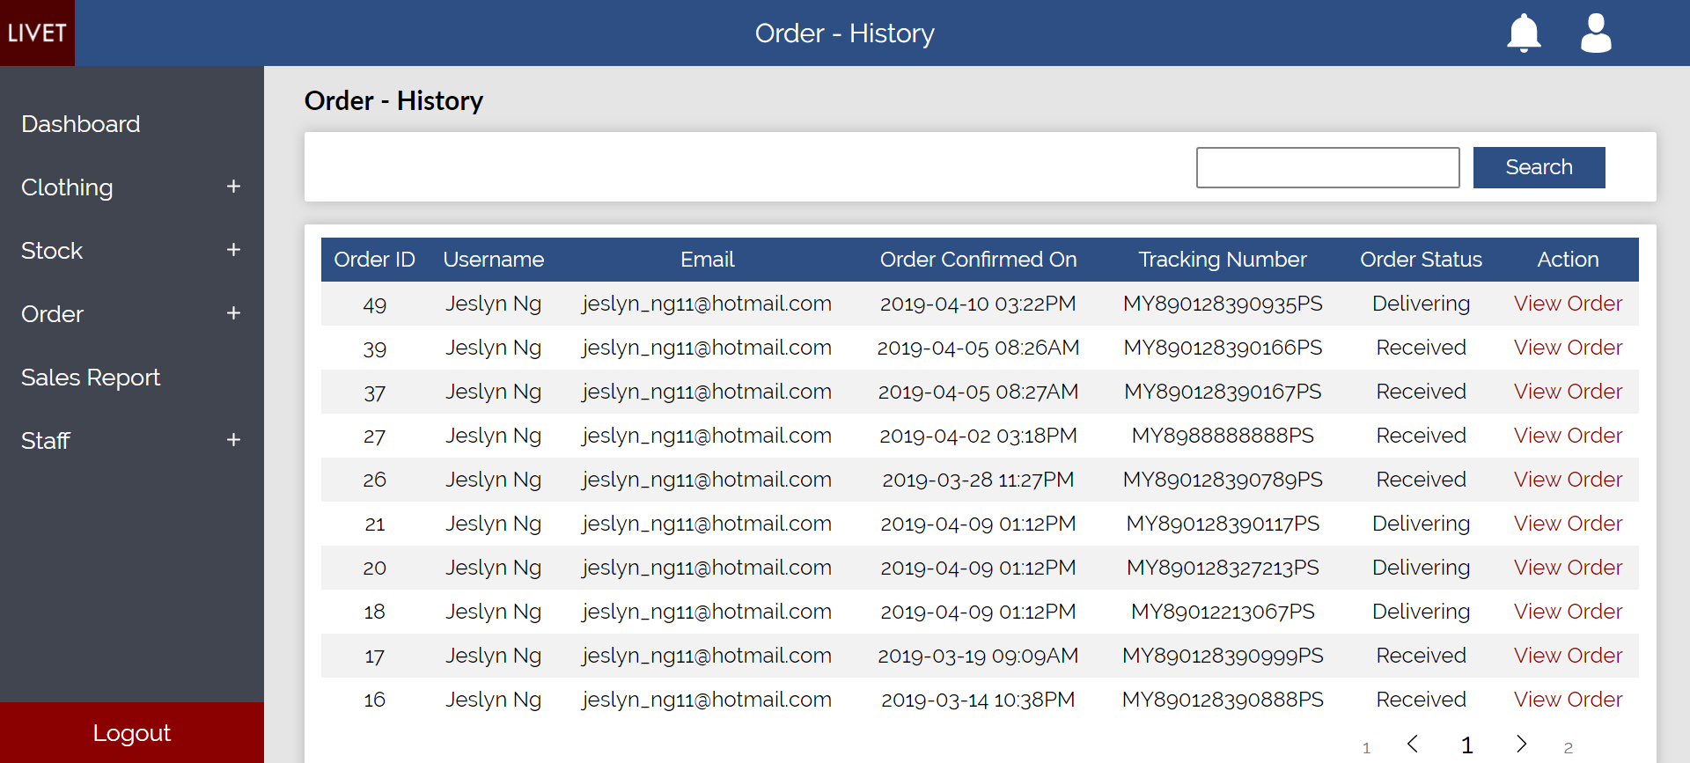
11
Order -> History
Search filter
View order details for this item

Slide 12
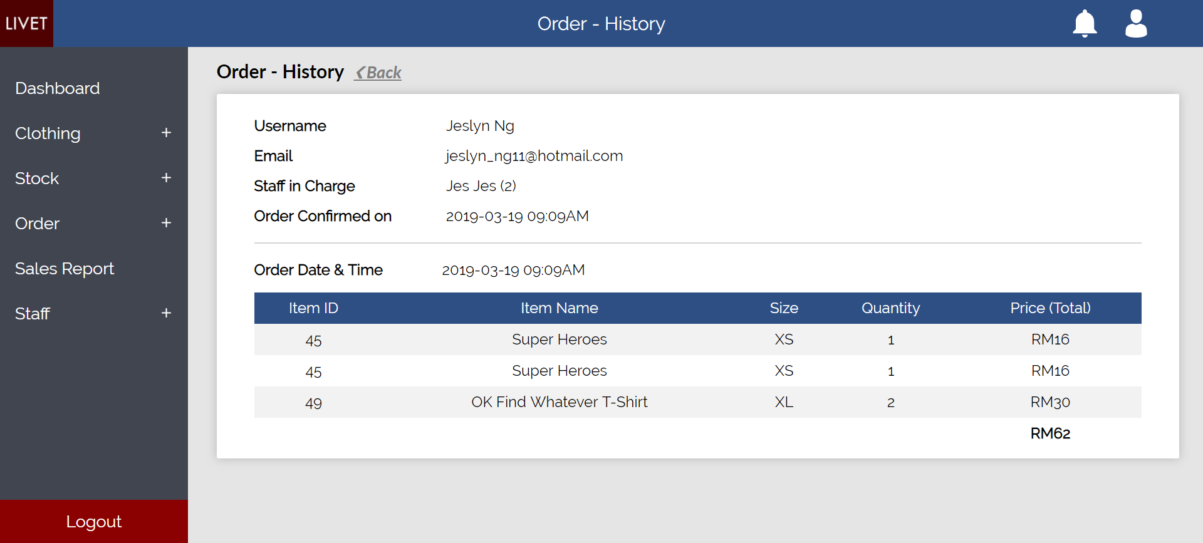
12
Order -> History -> View Order Details
Order Information
Total Payment

Slide 13
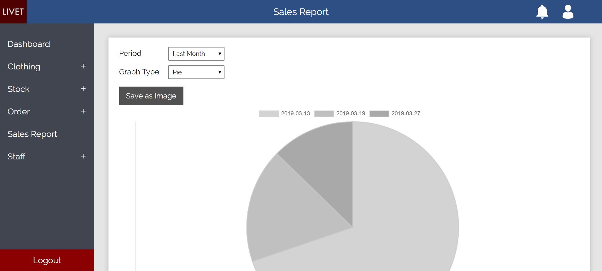
13
Sales Report
Search Filter
Download Report

Slide 14
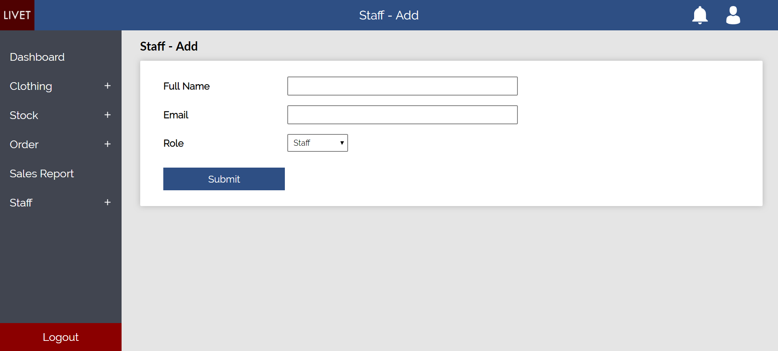
14
Staff -> Add
New Staff Details
Email will be sent

Slide 15
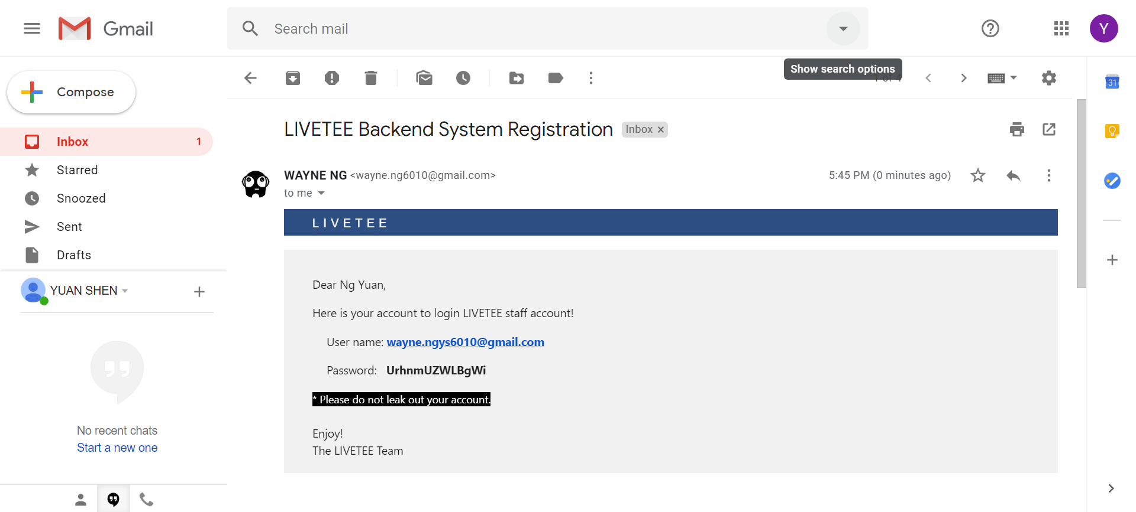
15
Email of new staff
Email of new staff
Login details

Slide 16
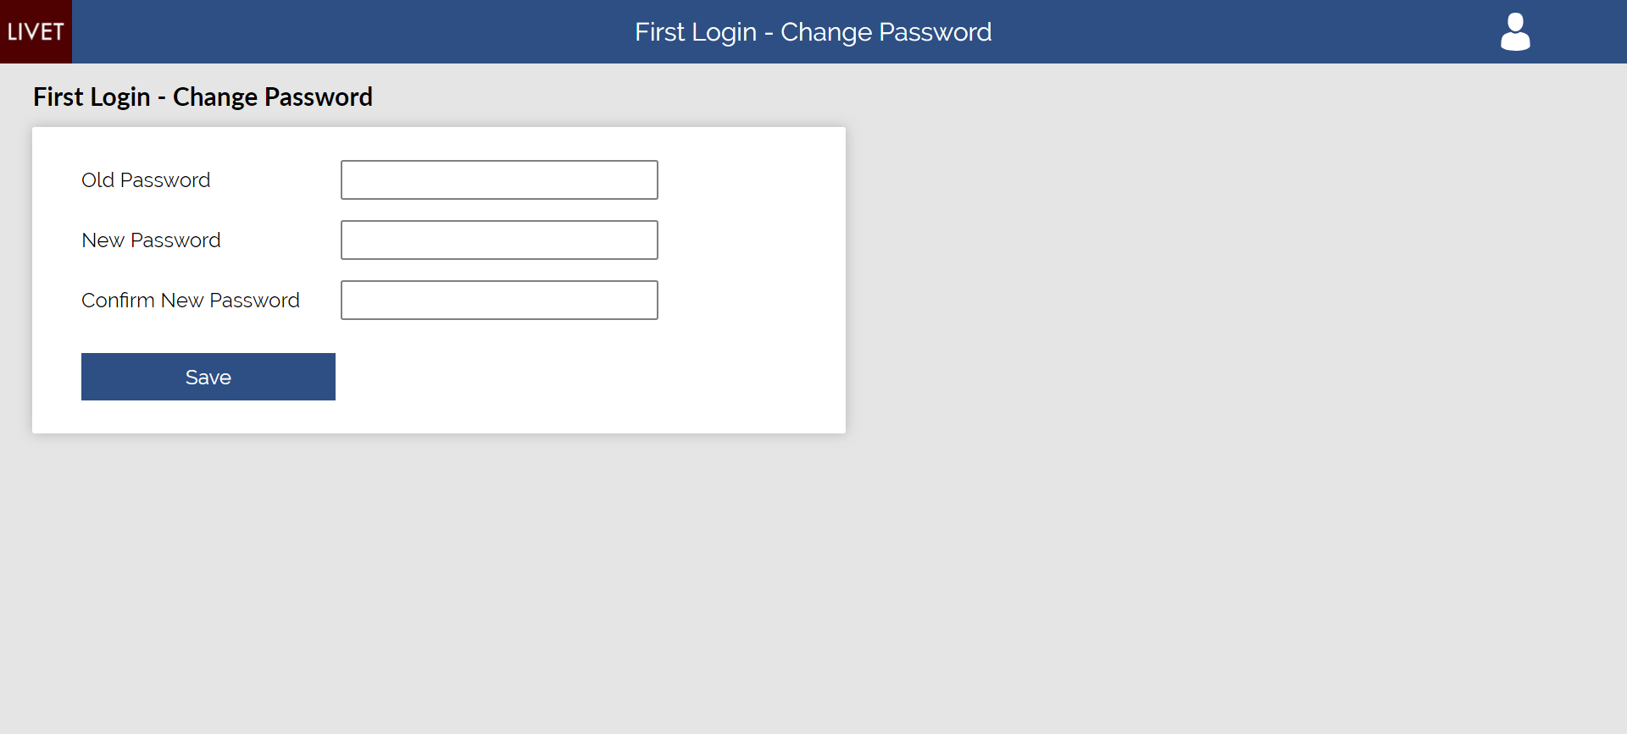
16
First login of new staff
Change password before able to access to the system

Slide 17
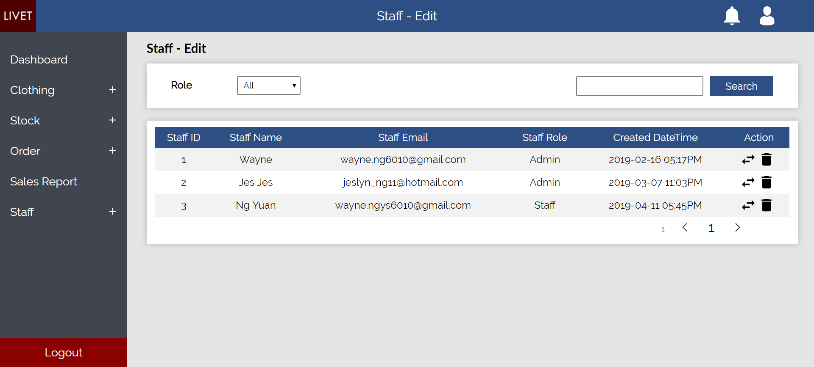
17
Staff -> Edit
Search filter
Change the role of this staff
Delete this staff from system

Slide 18
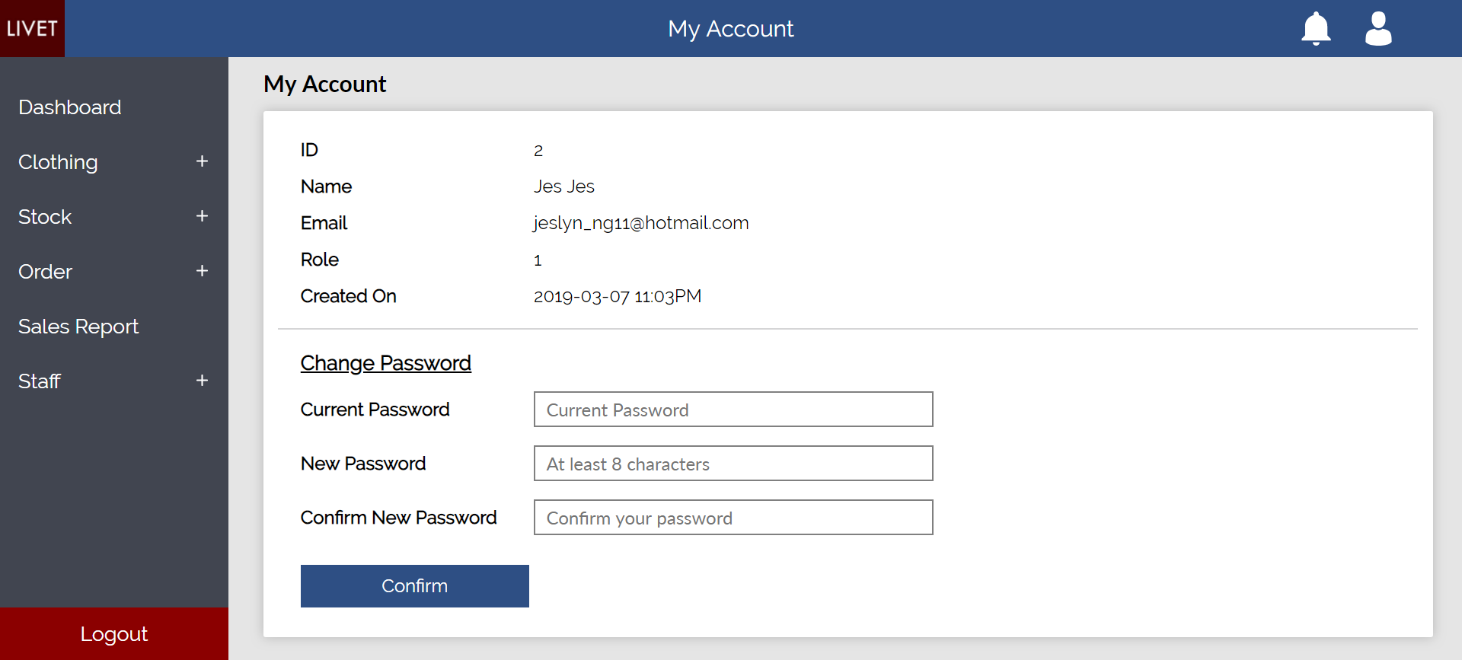
18
My Account (Change Password)
Account
Details
Enter current password and new password

Slide 19
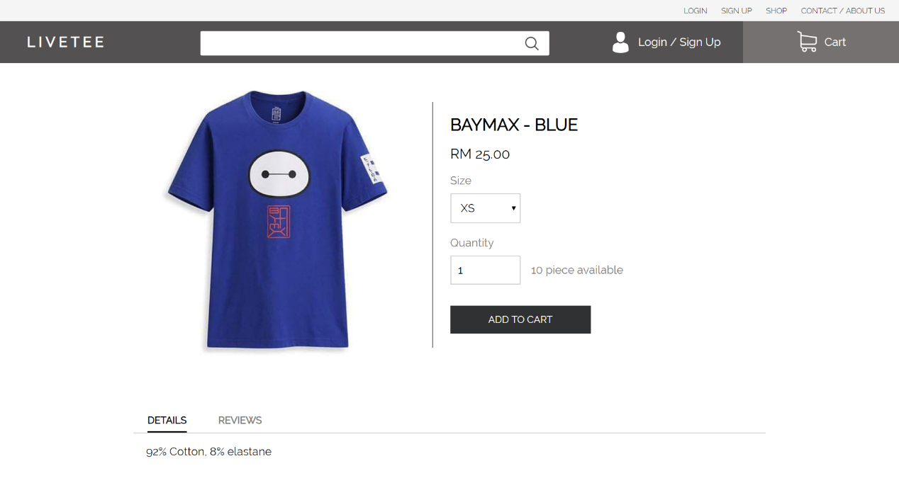
1
Product
Select size
Select quantity
Stock Available
Product details
Reviews by other user

Slide 20
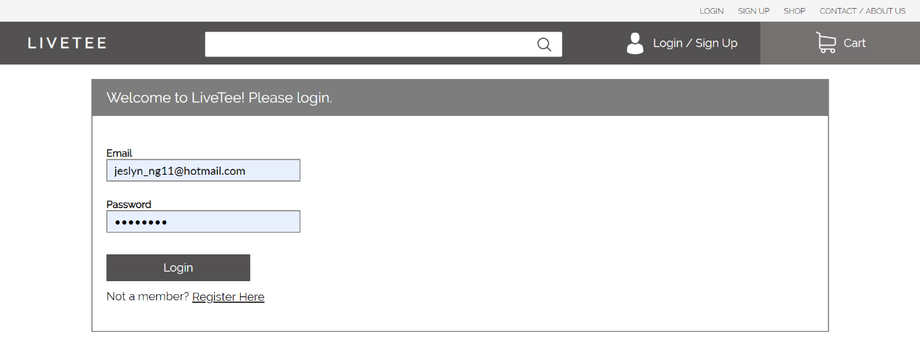
2
Login
Enter email and password
Register an account

Slide 21
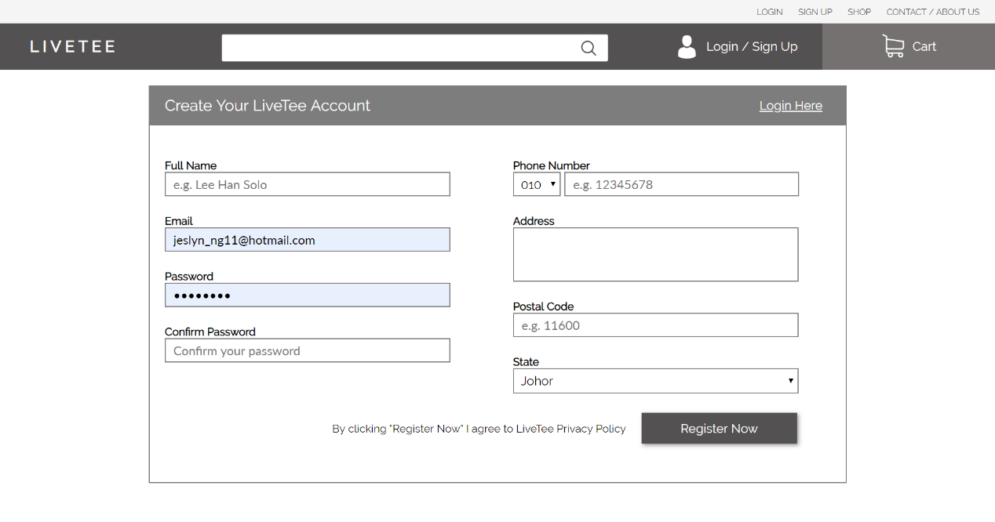
3
Register
Enter personal information

Slide 22
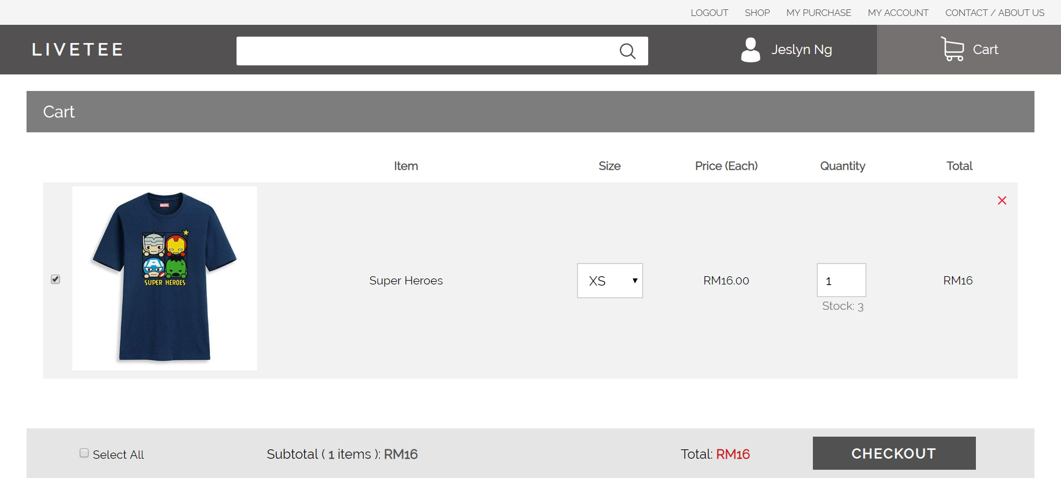
4
Cart
Edit quantity
Edit Size

Slide 23
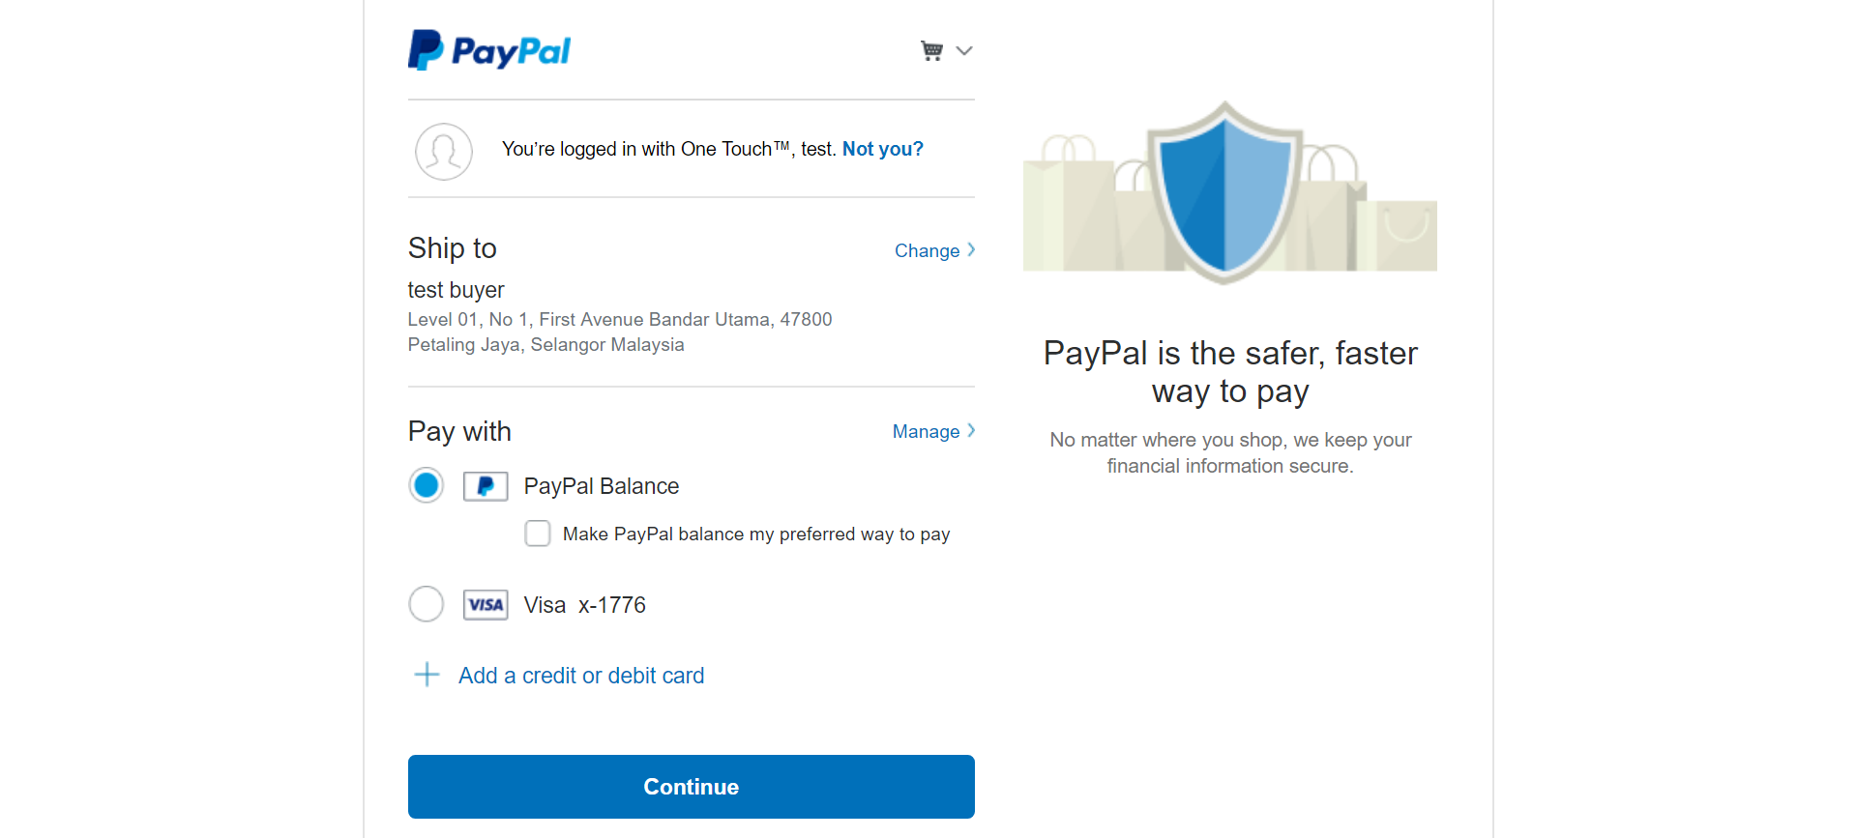
5
Checkout
Set payment method

Slide 24
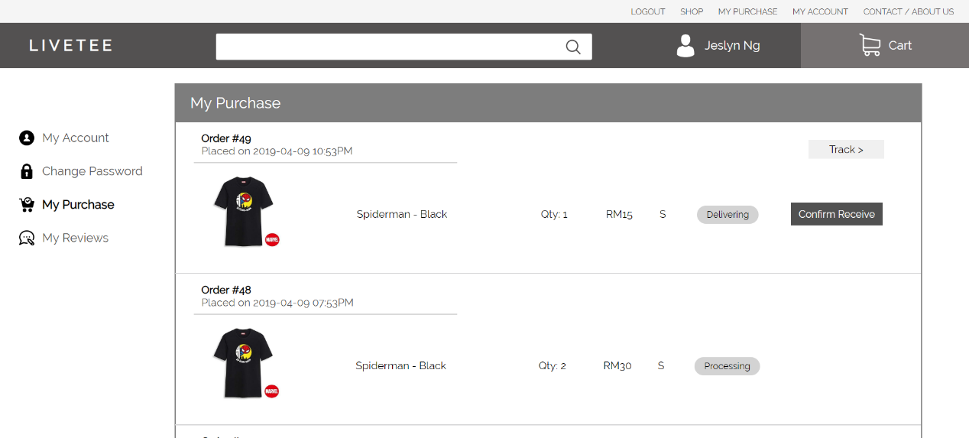
6
My Account -> My Purchase
Order tracking
Order status

Slide 25
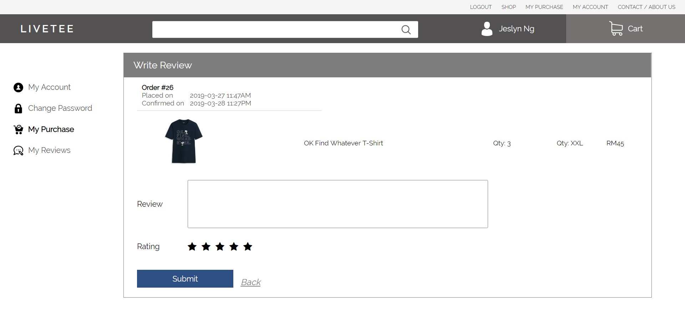
7
My Account -> My Purchase -> Write Review
Write review
Give rating

Slide 26
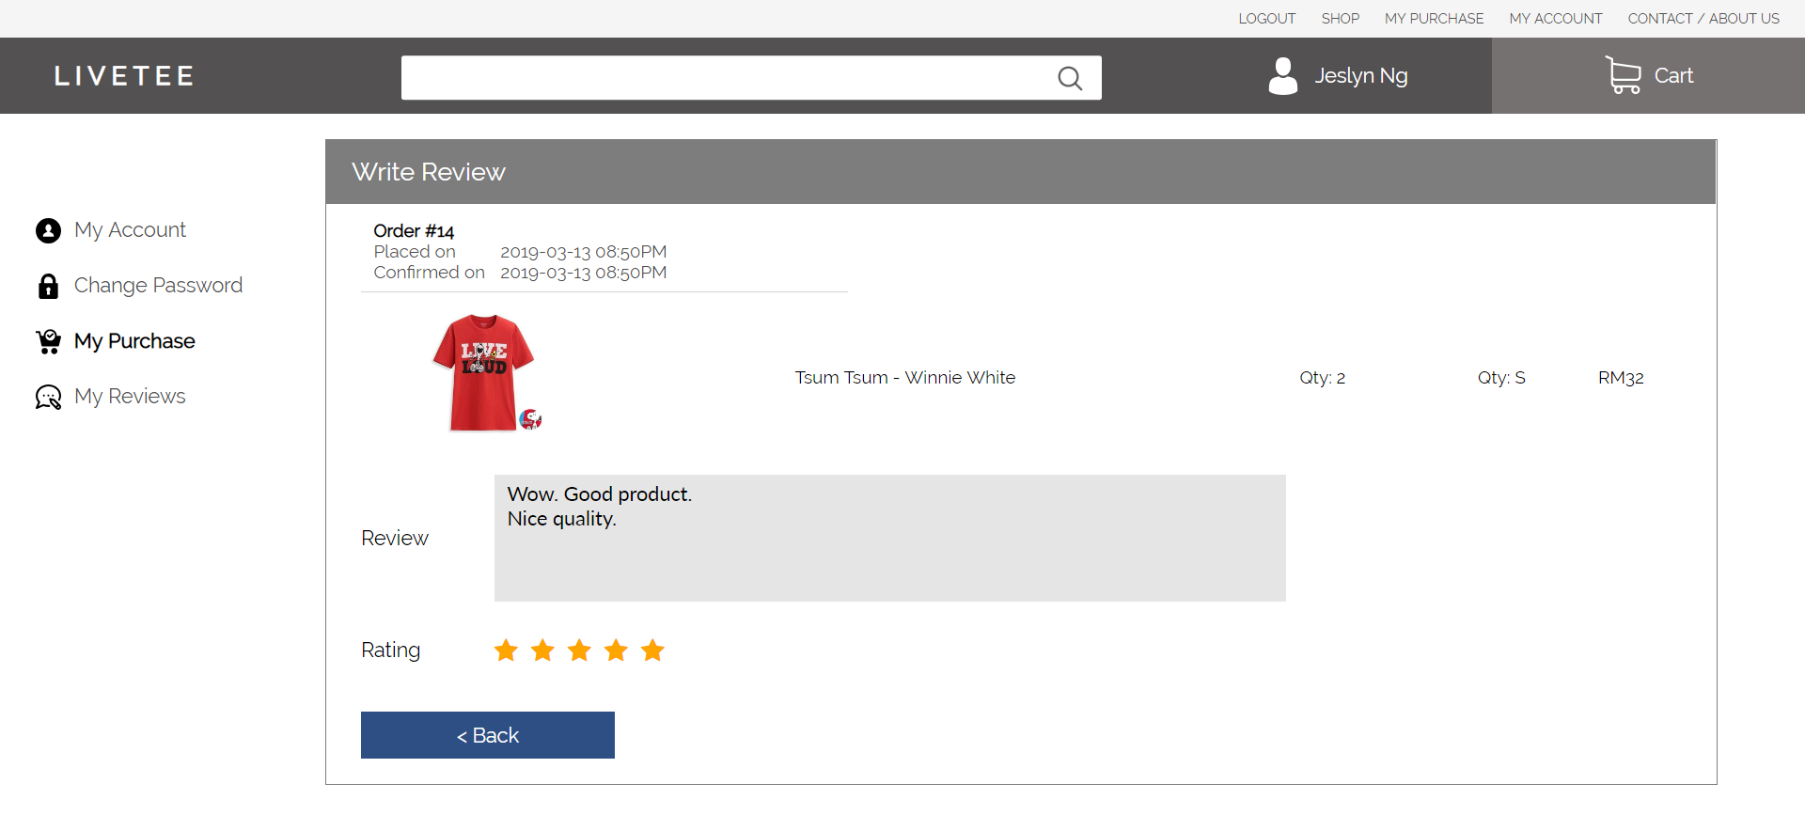
8
My Account -> My Purchase -> View Review
Review given
Rating given

Slide 27
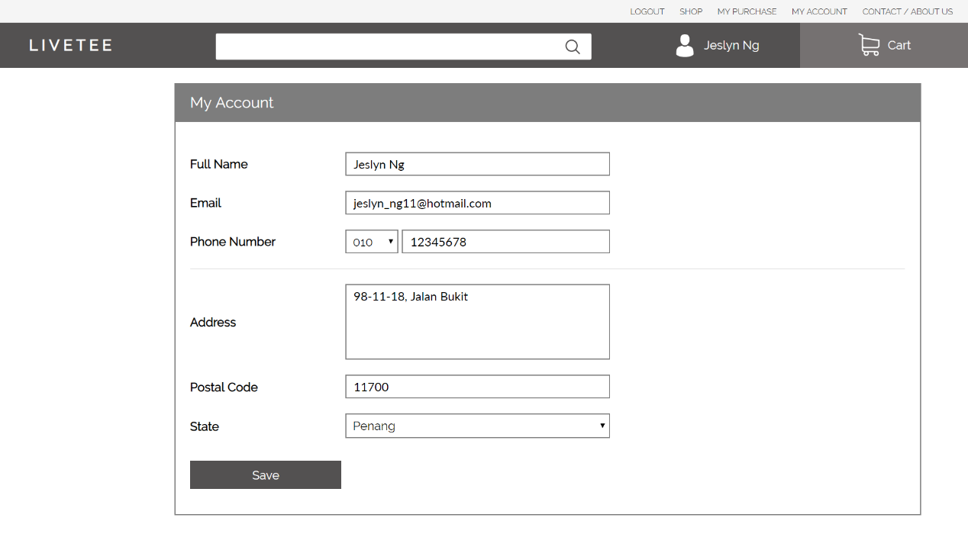
9
My Account
Edit personal information

Slide 28
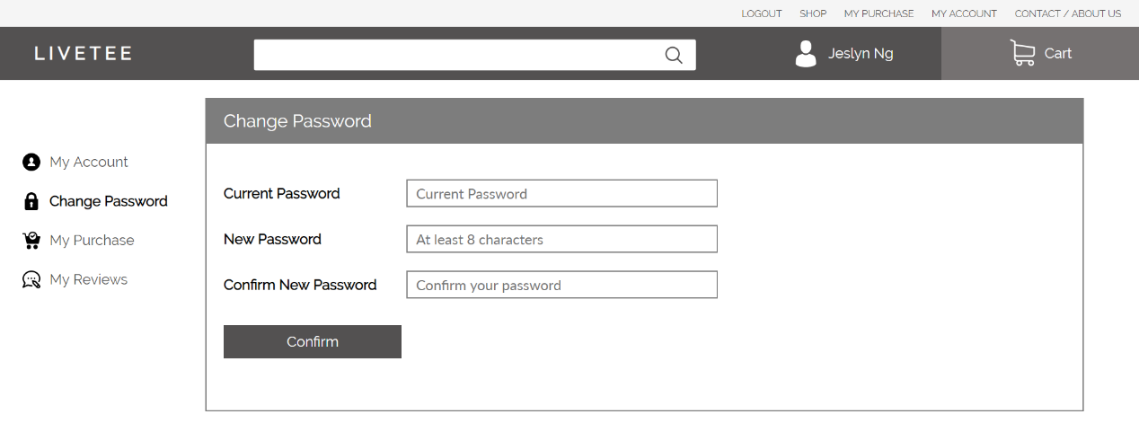
10
My Account -> Change Password
Enter old password and new password

